Slide 1

Sharing searches in PharmaPendium
Effective information sharing
Marnix Wieffer
Senior marketing manager drug safety
Notes:
Hello everybody and welcome to this tutorial video, where I will show you how you can share searches with PharmaPednium

Slide 2
Learning objective
How to share a search (link/email)
How to create and modify contact group
Share a saved or recent search
This should allow you to more effectively share PharmaPendium searches with your co-workers, thereby streamlining information exchange, collaboration and R&D productivity
Notes:
During this training session we will learn how we can share a search by through Link or email, How to create and modify contact group and also how we can share a saved or recent search This should allow you to more effectively share PharmaPendium searches with your co-workers, thereby streamlining information exchange, collaboration and R&D productivity

Slide 3
Example search
“Using PharmaPendium, I retrieved important adverse effect data on QT prolongation in dog, on drugs acting on Cyclin-dependent kinases.”
“I would like to share this search with my colleagues of the preclinical toxicology department as they will soon start preclinical work on compounds acting on Cyclin-dependent kinases soon.”
Suggested watch: Introduction to retrieving drug safety data
Notes:
Let’ assume that I did a drug safety data search and we would like to share the data with a specific colleague or a group.
For example, Using PharmaPendium, I retrieved important adverse effect data on QT prolongation in dog, on drugs acting on Cyclin-dependent kinases. This is critical information to assess risk, select the right animals and experimental design.
I would like to share this search with my colleagues of the preclinical toxicology department as they will soon start preclinical work on compounds that also act on Cyclin-dependent kinases soon.
If you would like to know more about how to set up this specific drug safety search, I would recommend to watch the introduction to retrieving drug safety data in PharmaPendium tutorial video

Slide 4
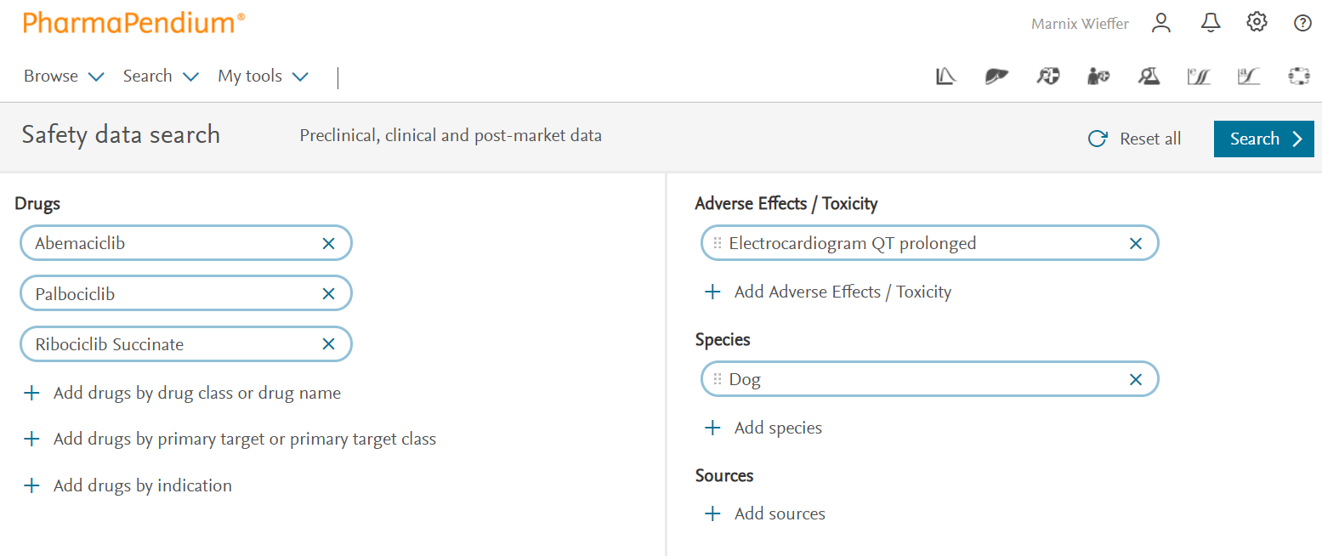

Searches from my different data modules can be shared
Starting point:
Text search
PK search
MET search
Chemistry search
Efficacy search
Activity search
FAERS Search
DDI risk calculator
Notes:
However, you can also start with a search in any of the PharmaPendium data modules, including FAERS and the DD.
Here I already set up our search example search in PharmaPendium and let’s hit search.
Now to share this search we can simply click on the “share” Icon in the right upper hand corner. Important, to use the share feature, you need to be logged-in to PharmaPendium

Slide 5
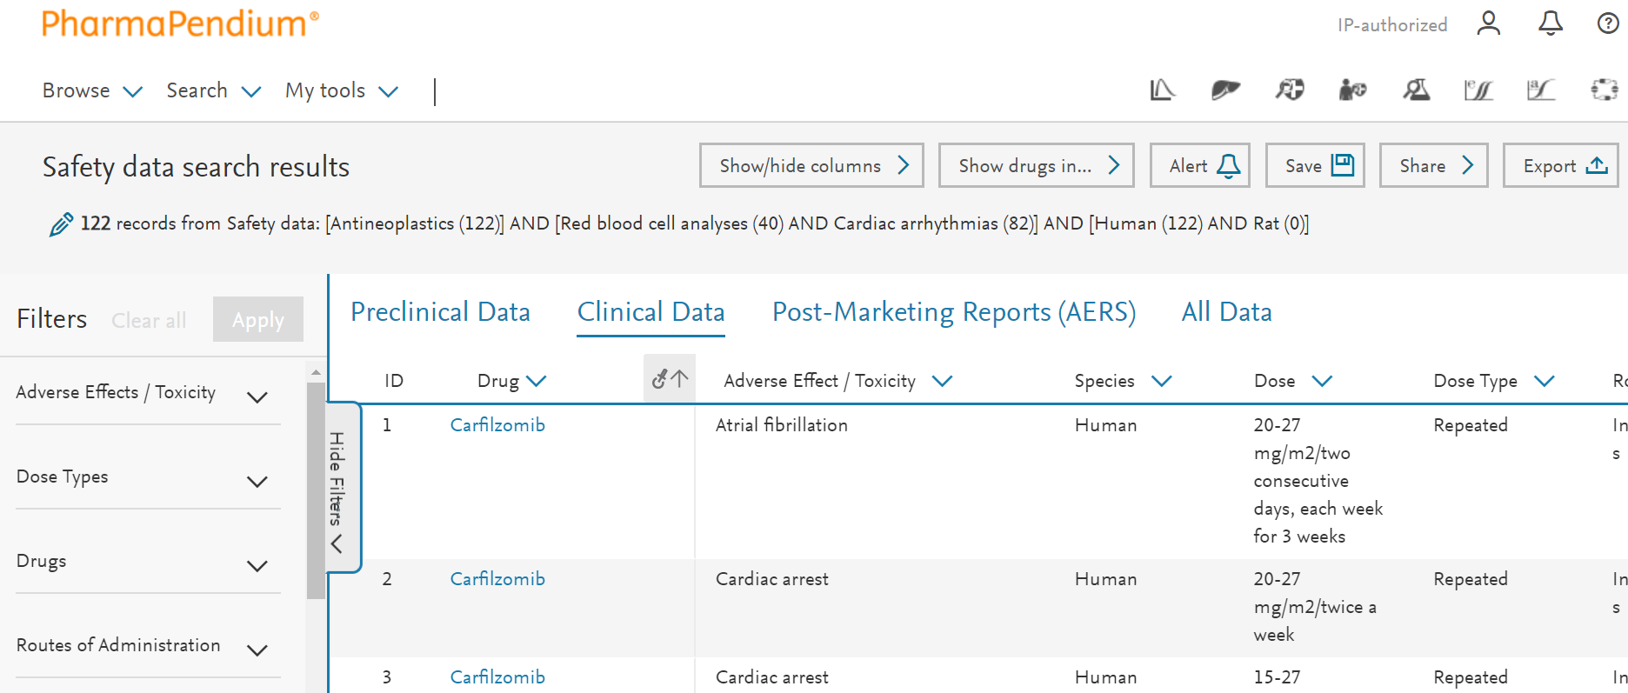
Share button visible on result page
Notes:
However, you can also start with a search in any of the PharmaPendium data modules, including FAERS and the DD.
Here I already set up this search example search, and let’s hit search
To share a search we can simply click on the “share” Icon in the right upperhand corner. Important, to use the Share feature, you need to be logged-in to PharmaPendium

Slide 6
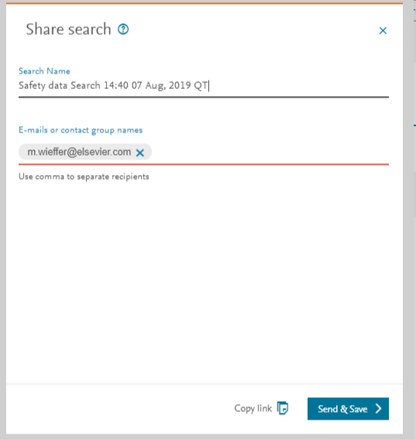
Searches can be shared with individuals or groups
Customize search name
Type email addresses of individual recipients or group name
Or copy share link into document or email
Notes:
Now we can customize the name of our search
Further we need to define the recipients. We can either use comma-separated email addresses or group name. We will talk about group names in a bit, for this example I will send the email to myself.
https://pp-trunk.cm-elsevier.com/redirect/shared?uuid=a5058847-298a-4128-ba9c-ba05fa4ec4b5

Slide 7
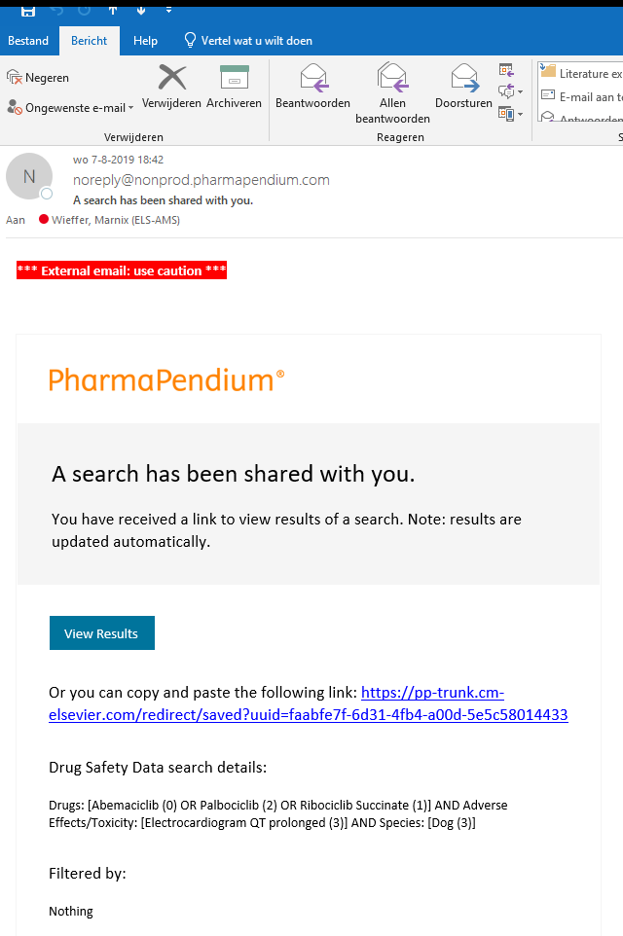
Recipients receive an email with link
Clicking “view results” will rerun the search
Recipient needs access to PharmaPendium
Recipient needs to login to PharmaPendium
Check spam folder
Mark emails from noreply@nonprod.pharmapendium.com as safe
For instructions, click here
Notes:
PharmaPendium will now rerun the search, thereby providing an up to date results overview. The recipient can now work with the data, if they like, look a the query by clicking on the pen symbol

Slide 8
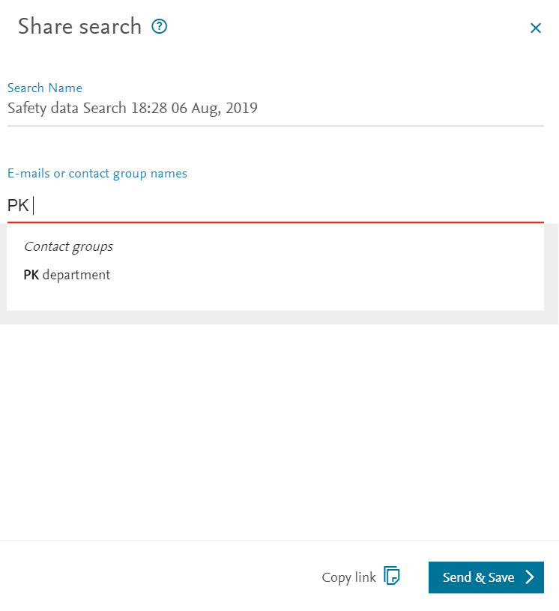
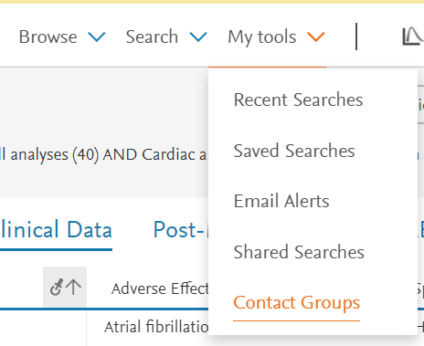
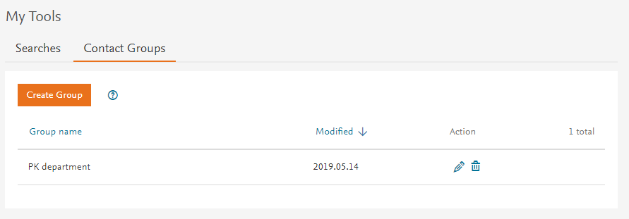
A contact group is a set of recipients defined by you
Go to “contact group” under my tools
Create or modify contact groups
Now you can share searches with this contact group
Notes:
Next to sending sharing our searches with individual user based on email, we can also share our search with a contact group. A contact group is a group of people with whom we would like to frequently share a search,
By creating a contact group we avoid having to type all the email addressed all the time
We can also share a search with a contact group. To define a contact group we go “contact group” under “my tools a
To modify an existing contact group, click on the pen symbol. You can add, remove of modify email addressed in the contact group.

Slide 9
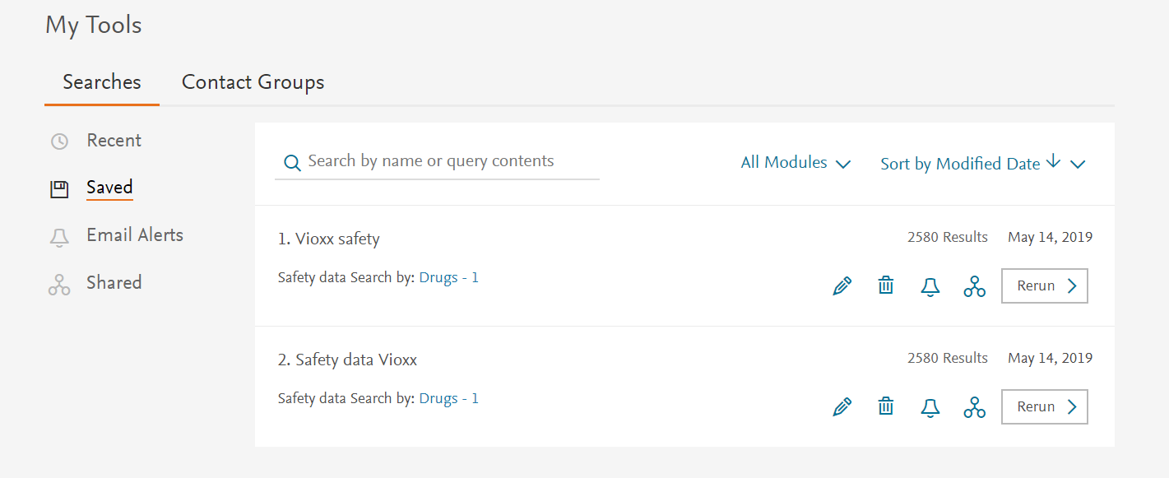
Recent and Saved searches can also be shared
Notes:
Further, we can also share a saved search

Slide 10
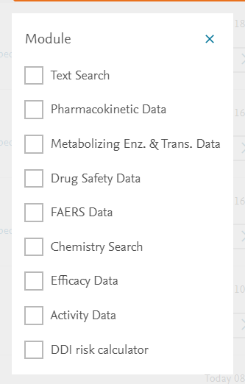
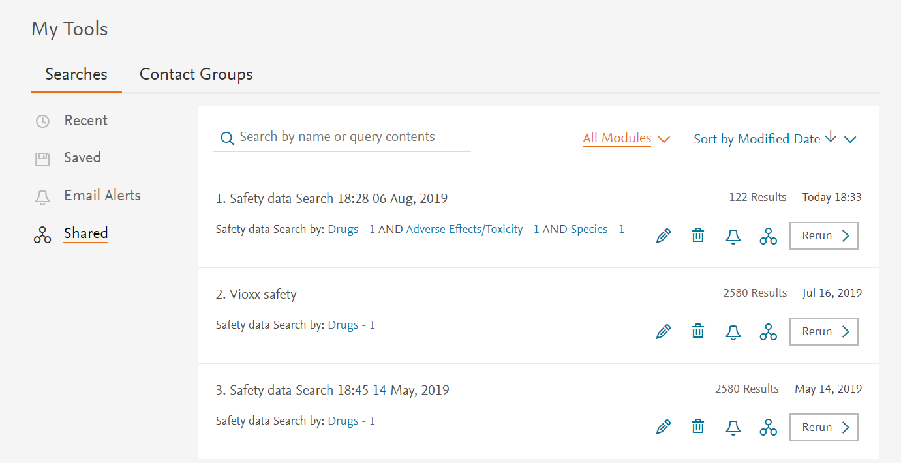
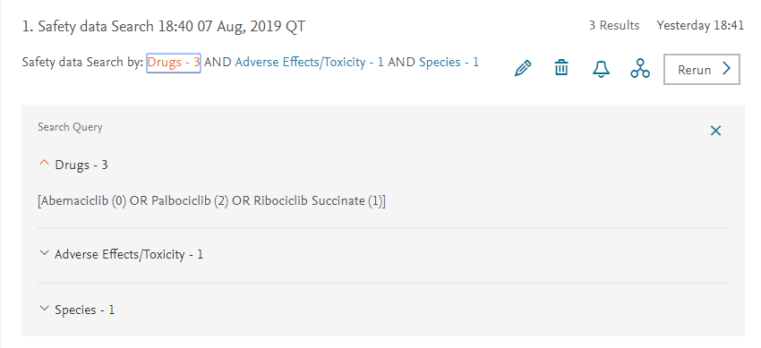
Shared searches are saved and can be modified or rerun
Open up search details
Filter shared searches by module

Slide 11
Notes:
Hopefully I have provide sufficient information to start sharing searches with your colleagues, thereby making sure information is more effectively shared. With that I would like to thank you for your attention. I case of questions, please do not hesitate to get in touch.

